Slide 1
報告者：
07370002 王成嘉
Adapting RNN Sequence Prediction Model
to Multi-label Set Prediction
Kechen Qin Cheng Li Virgil Pavlu Javed A. Aslam
Khoury College of Computer Sciences
Northeastern University

Slide 2
Content
Introduction
Mapping Sequences to Sets
Adapting RNN Sequence Prediction Model to Multi-label Set Prediction
  How is our new formulation different?
  Training by Maximizing Set Probability
Results and Analysis
  Experimental Setup
  Experimental Results
  Analysis: Sequence Probability Dsitribution
Case Analysis
Conclusion

Slide 3
Abstract
Set V.S. Sequence
Multi-label classification(MLC) problem for text
Target: a set of labels
RNN models define probabilities for sequences but not for sets
obtain a set probability, including:
  pre-specifying the label order
  relating the sequence probability to the set probability in ad hoc ways

Slide 4
Abstract
Our Formulation
  derived from a principled notion of set probability
  sum of probabilities of corresponding permutation sequences for the set
  new training objective: maximizes set probability
  new prediction objective: find the most probable set on a test document
  give the RNN model freedom to discover the best label order
  …….
  作者表示自己的模型就是比較好!

Slide 5

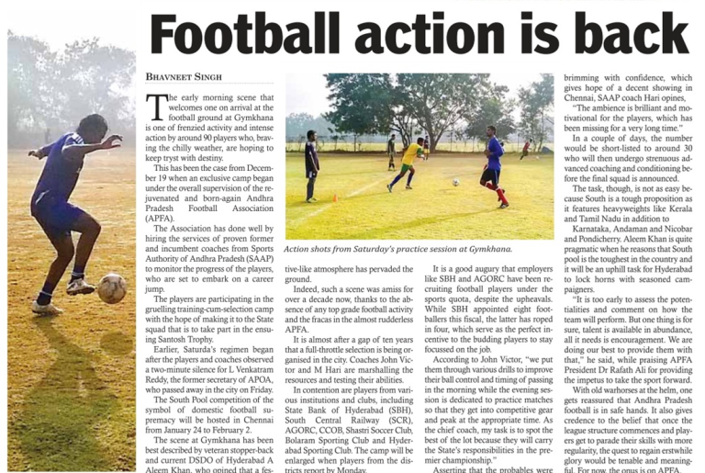
Introduction
Multi-label text classification is an important ML task
predict a set of labels to associate with a given document
Football
2018 world cup
sport
Russian

Slide 6
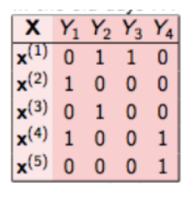
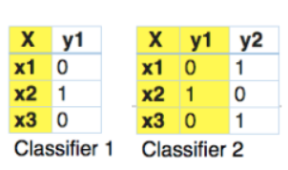
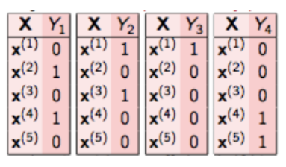
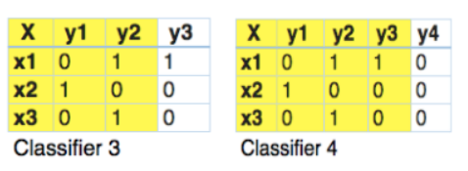
BR
多標籤轉為單標籤問題
Classifier Chain

Slide 7




Introduction
Binary Relevance
a set of label candidates
aim to build a classifier
maps a document to a set of labels
binary vector
predict each label independently
presence or absence of a label
忽略了標籤的相關性

Slide 8


Introduction
To capture label dependencies by building a joint probability estimation over all labels:
Probabilistic Classifier Chain (PCC)
binary decision is made for each label sequentially
learns labels one-by-one
predefined fixed order
use one classifier to estimate the probability of each label
given all previous labels predictions:
Drawback:
  errors in early probability estimations tend to affect subsequent predictions
  become massive when L is large

Slide 9
BR
Classifier Chain

Slide 10
Introduction
RNN
applied to MLC by mapping label set to a sequence
Only predicts the positive labels
decision chain length = positive labels
PCC & RNN
Both rely heavily on label order in training and prediction
In multi-label data, labels are given as sets
RNN defines sequence probability
PCC defines set probability

Slide 11
Introduction
Arranging sets as sequence
ordering alphabetically
frequency
label hierarchy
label ranking algorithm
Previous experimental results show that which order to choose can have a significant impact on learning and prediction
- Vinyals et al., 2016

Slide 12
Introduction
Previous work
RNN can explore different label orders and converge to some order automatically (Vinyals et al., 2016)
RNN sequence model to multi-label set prediction without specifying the label order
This Paper:
Propose new training and prediction objectives
based on a principled notion of set probability
gives RNN model freedom to discover the best label order

Slide 13










Mapping Sequences to Sets
Review RNN designed for sequences
Input Sequences of outcomes:
Particular order:
probability distribution over all possible output sequences given the input in the form :
At prediction time, find Sequence with the highest probability:
Use Beam Search
with the attention mechanism, label probability distribution at time t:

Slide 14
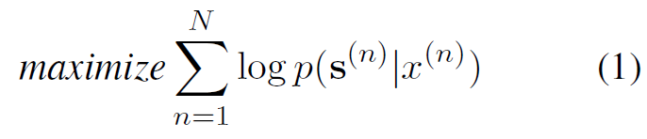
Mapping Sequences to Sets
Apply RNN to multi-label problems, one approach…
map the given set of labels y to a sequence
globally fixed order (frequency, in PCC)
Mapping is done
(Nam) RNN is trained with the standard maximum likelihood objective :

Slide 15
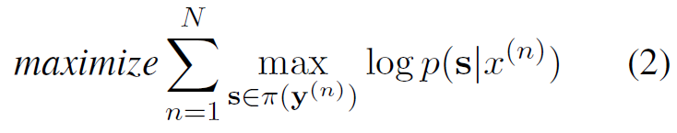


Mapping Sequences to Sets
(Vinyals) dynamically choose the sequence order as most probable during training:
stands all permutations of
Drawback:
  cannot be used in the early training stages
  early order choice is reinforced by this objective and can be stuck upon permanently

Slide 16
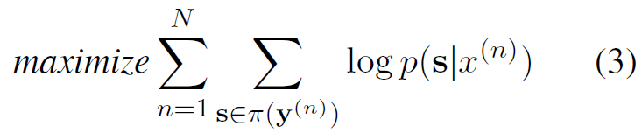
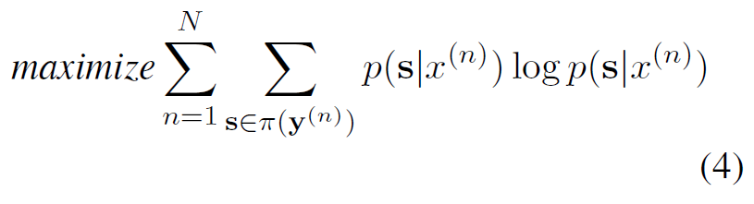
Mapping Sequences to Sets
(Vinyals) proposes two smoother alternative objective:
  consider many random orders for each label set
  Sample sequences follow model predictive distribution not uniform distribution
  self reinforcement issue

Slide 17

Mapping Sequences to Sets
Training : schedule the transition among objectives
Prediction : find the most probable set
This is done by finding the most probable sequence
treating it as a
many sequences: argmax with low probability
ignore sequences except top one lead to neglecting important information

Slide 18


Adapting RNN Sequence Prediction Model to Multi-label Set Prediction
Set-RNN
We define set probability as sum of sequences probabilities
all sequence permutations of the set, namely:
Probability distribution over all possible sets:

Slide 19


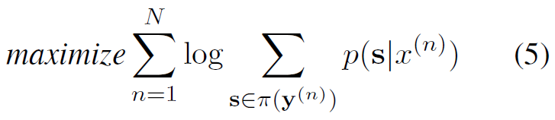
Adapting RNN Sequence Prediction Model to Multi-label Set Prediction
Set-RNN
maximize the likelihood of given label sets, namely

Slide 20
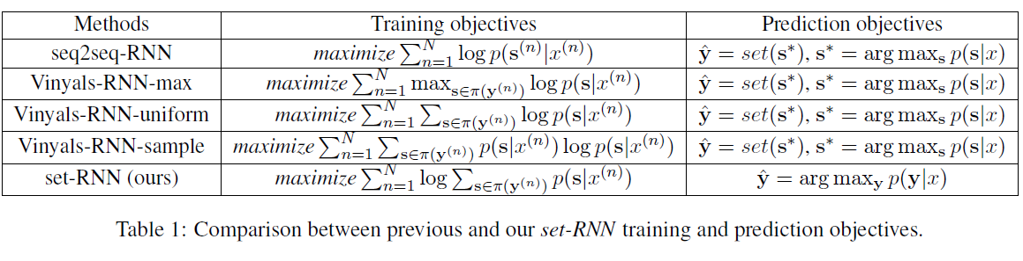

Slide 21



3.1How is our new formulation different?
Multiplication
To maximize the set probability, RNN model has to assign equally high probabilities to all sequence permutations of the given label set
Summation
different documents can have different label orders
gives RNN model more freedom on label order

Slide 22
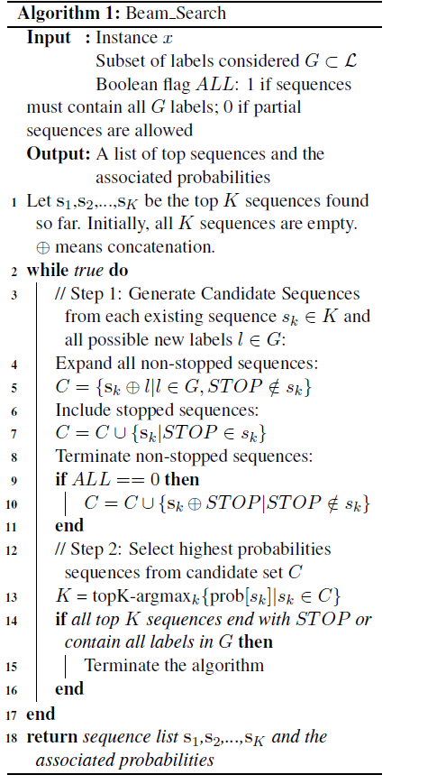
3.2 Training by Maximizing Set Probability
Training an RNN with (5) requires summing up sequence (permutation) probabilities for a set y
approximate this sum by only considering the top K highest probability
variant of beam search for sets with width K
with the search candidates in each step restricted to only labels in the set (see Algorithm 1 with ALL = 1)
This approximate inference procedure is carried out repeatedly before each batch training step

Slide 23
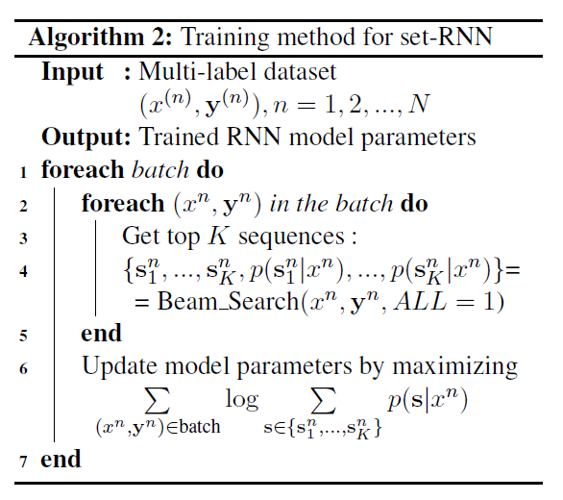
3.2 Training by Maximizing Set Probability
find highest probability sequences for all training instances occurring in that batch
The overall training procedure:

Slide 24
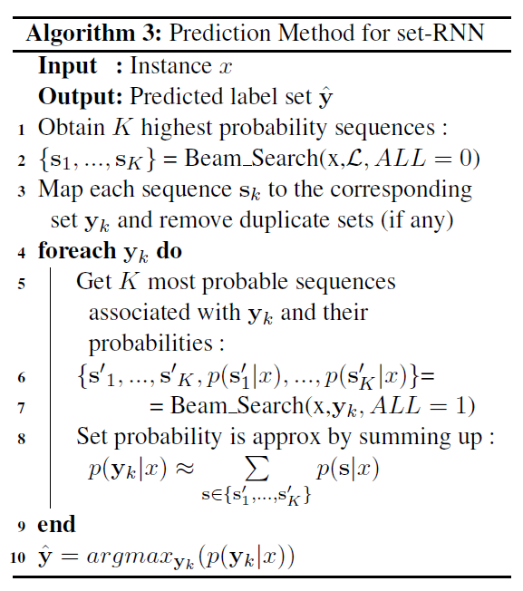


3.3 Predicting the Most Probable Set
two-level beam search
run standard RNN beam search (Algorithm 1 with ALL = 0)
generate a list of highest probability sequences
consider the label set associated with each label sequence
evaluate each set probability (Algorithm 1 with ALL = 1)
find top few highest probability sequences associated with the set
sum up their probabilities
choose the highest probability as the prediction
the most probable set may not correspond to the most probable sequence

Slide 25
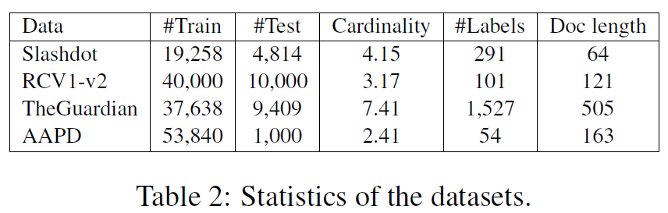
Results and Analysis
4.1 Experimental Setup
filter out stopwords and punctuations
Truncat document
  TheGuardian & AAPD: max 500
  Slashdot & RCV1-v2: max 120
less words than the maximum number :Zero padding
Numbers and out-of-vocabulary words are replaced with special tokens
Words, user tags and labels are all encoded as 300-dimensional vectors using WORD2VEC (Mikolov et al., 2013)
We implement RNNs with attention using TENSORFLOW-1.4.0 (Abadi et al., 2016)
The dynamic function for RNNs is chosen to be GRU
  2 layers
  at most 50 units in decoder
  GRU unit is 300
dropout rate = 0.3
train the model with Adam optimizer (Kingma and Ba, 2014)
with learning rate 0:0005
Beam size :12

Slide 26
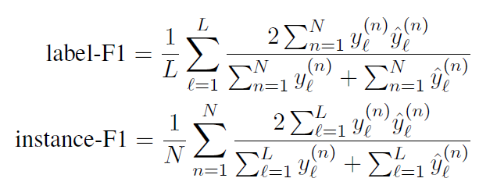



Results and Analysis
4.1 Experimental Setup
Evaluation metrics
for each instance n
  = 1 if label is a given label in ground truth
  = 1 if label is a predicted label
instance-F1 : basically determined by the popular labels’ performance
label-F1 : sensitive to the performance on rare label

Slide 27


Results and Analysis
Binary Relevance (BR)
BR-support (Binary Relevance with support inference) (Wang et al., 2018)
  trains binary classifiers independently
  imposes label constraints at prediction time (僅考慮訓練期間觀察到的標籤集)
PCC: chain of binary classification problems (predictions are made with Beam Search)
Seq2Seq : maps each set to a sequence by decreasing label frequency
Vinyals
  Vinyals-RNN-uniform, Vinyals-RNNsample, and Vinyals-RNN-max
  trained with different objectives that correspond to different transformations between sets and sequences
  Vinyals-RNNsample and Vinyals-RNN-max are initialized by Vinyals-RNN-uniform
Vinyals-RNN-max-direct :
  Vinyals-RNN-max directly without Vinyals-RNN-uniform as initialization
Sequence Generation Model (SGM):
  similar to seq2seq-RNN
  new decoder structure
  computes a weighted global embedding based on all labels
  Not just the top one at each timestep

Slide 28
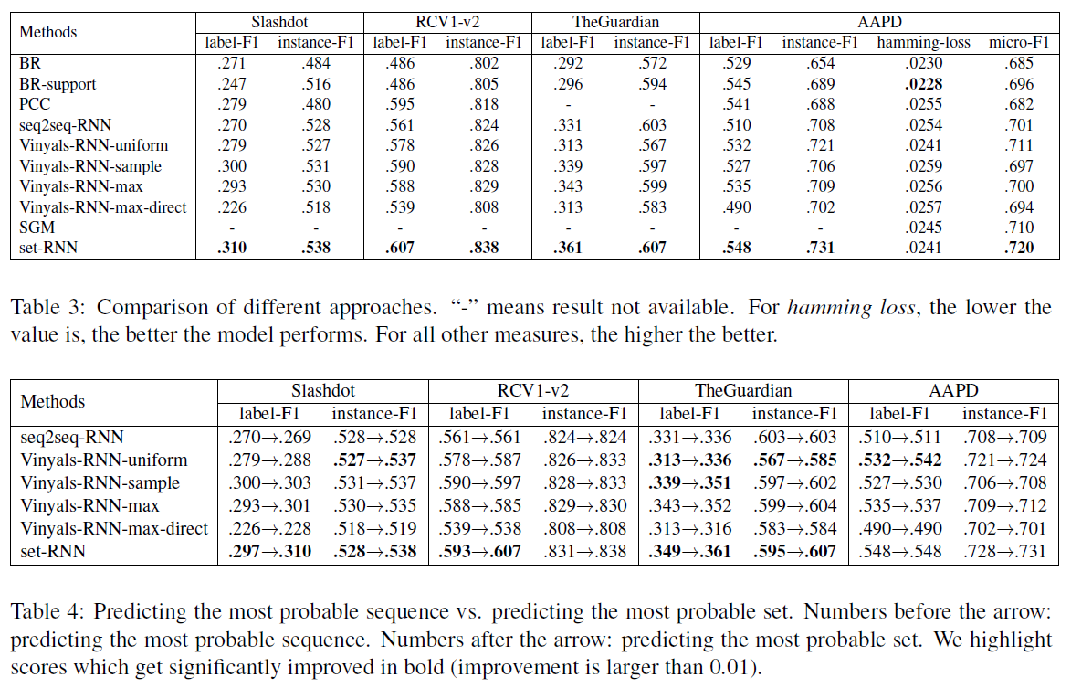
Set-RNN : performs the best in all metrics on all datasets
Vinyals-RNN-max and Vinyals-sample : perform not bad but degrades significantly
instance-F1 : basically determined by the popular labels’ performance
label-F1 : sensitive to the performance on rare label

Slide 29
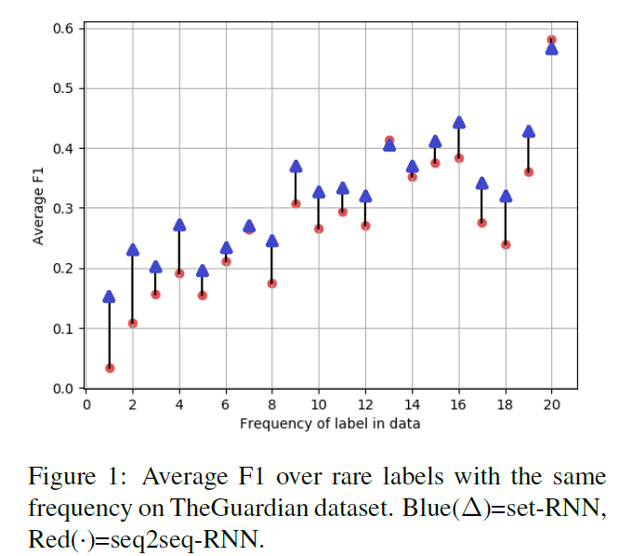
Results and Analysis
4.2 Experimental Results
set-RNN predicts rare labels better than seq2seq-RNN

Slide 30
4.2 Experimental Results
analyze benefit
test two prediction strategies
  1) finding the sequence with the highest probability and outputting the corresponding set
  (default prediction : all models except set-RNN)
  2) outputting the set with highest probability (default prediction : set-RNN)
Vinyals-RNN-uniform, set-RNN benefit most from predicting the top set
Perform promotion: model has to spread probability mass across different sequence permutations of the same set

Slide 31
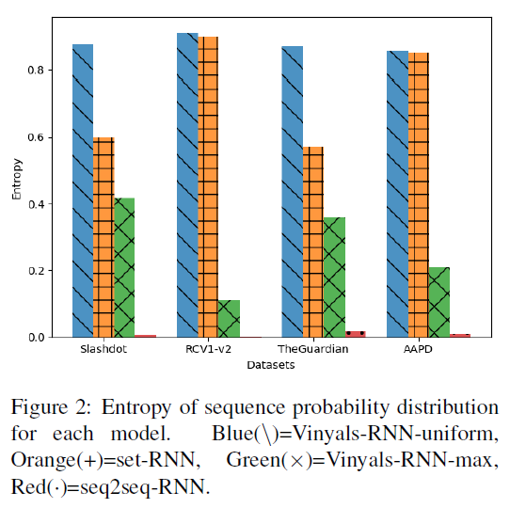
Results and Analysis
4.3 Analysis: Sequence Probability Distribution
How sharply (or uniformly) distributed the probabilities over different sequence permutations of the predicted set
Normalize sequence probabilities related to the predicted set
compute the entropy
Smaller entropy values = sharper distributions
predictions with different set sizes should be comparable
Entropy/(log number of sequences)
Result:

Slide 32
Results and Analysis
Red(seq2seq-RNN):
  trained with fixed label order & standard RNN objective
  generates very sharp sequence distributions
  only assigns probability to one sequence in the given order
  entropy close to 0
  predicting the set = predicting the top sequence
Blue(Vinyals-RNN-uniform)
  spreads probabilities across sequences
  leads highest entropy
  From Table 4, Vinyals-RNN-uniform perform improves
  Training with object(3) is impossible to discover and concentrate on a particular natural label order
  Overall Vinyals-RNN-uniform is not competitive even with the set-prediction enhancement.

Slide 33
Results and Analysis
Vinyals-RNN-max & set-RNN
Both allowed to assign probability mass to a subset of sequences
Green(Vinyals-RNNmax)
  sharper sequence distributions than set-RNN
  because it intend to allocate most probability to the most probable sequence
  due to max operator in training objective:
Orange(set-RNN)
  From Table 4:
    set-RNN 表現最好
    Vinyals-RNN-max表現普通

Slide 34
Results and Analysis
Slashdot and TheGuardian
benefit more from predicting the most probable set than RCV1 and AAPD
Because larger label cardinalities(基數)
more permutations for one set potentially

Slide 35
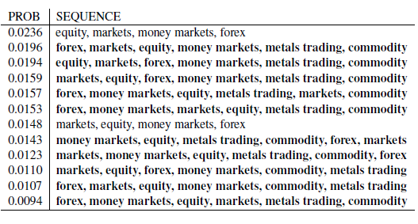
Case Analysis 01
set-RNN works with two examples
RCV1-V2 (set-RNN)
most probable set (also correct set here) predicted by set-RNN :
  {forex, markets, equity, money markets, metals trading, commodity} has the maximum total probability of 0.161
Top sequences (decreasing probability order) :

Slide 36
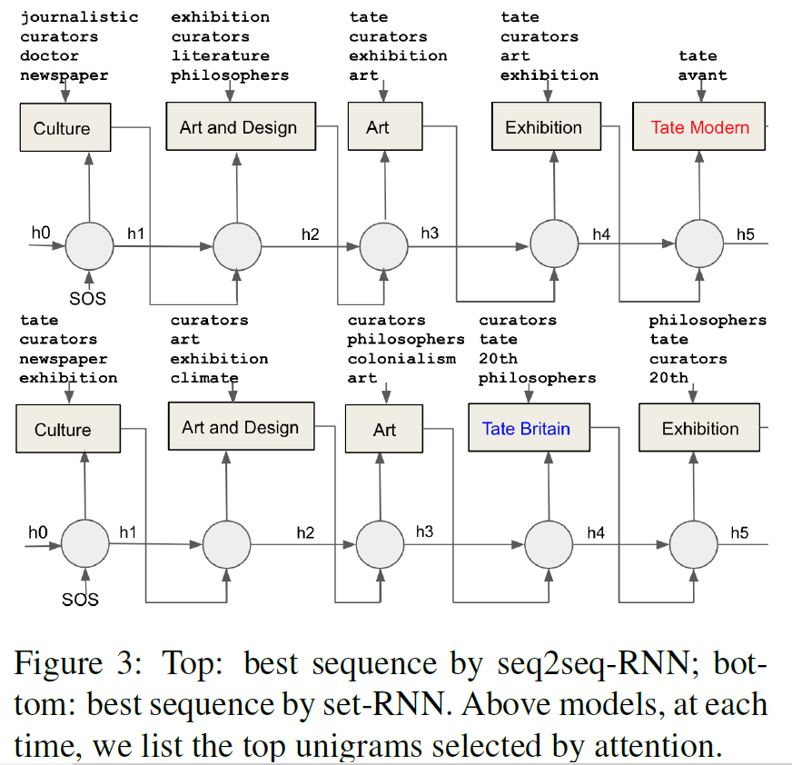
Case Analysis 02
TheGuardian (seq2seq-RNN V.S. set-RNN)
  seq2seq-RNN :Tate Modern (incorrect but more popular label)
  Set-RNN: Tate Britain (correct but less popular label)
Training data: Exhibition is more frequent than Tate Britain and Tate Modern
By decreasing frequency:
  Exhibition & Tate Modern: 19
  Exhibition & Tate Britain: 3
By set level (co-occurs):
  Exhibition & Tate Modern: 12
  Exhibition & Tate Britain: 22
本例而言，強加入序列順序會使概率估計產生偏誤，從而導致預測錯誤。

Slide 37
Conclusion
RNN only directly defines probabilities for sequences not for sets
Previous approaches:
  Transform a set to a sequence in some pre-specified order
  relate the sequence probability to the set probability in some ad hoc way
our formulation
  Derived from principled notion of set probability.
  We define the set probability as the sum of all corresponding sequence permutation probabilities
New training objective: maximizes the set probability
New prediction objective: finds the most probable set
give RNN model more freedom to automatically discover and utilize the best label orders

